Slide 1
LEACHING OF YAHYALI NON-SULPHIDE Pb-Zn FLOTATION TAILING USING ORGANIC ACIDS
Shokrullah Hussaini, PhD Candidate, Eskisehir Osmangazi University
Sait Kursunoglu, PhD, Abdullah Gul University
Muammer Kaya, Professor, Eskisehir Osmangazi University

Slide 2
THE MAIN OBJECTIVE OF THIS STDUY
In recent years, organic acids were investigated for recovering Zn from low grade Zn ores and Zn plant tailings.
It was recommended that acetic is more selective organic reagents than oxalic acid for the leaching of lead from Pb-free solder.
Due to the strong complexation of ferric iron and oxalate, oxalic acid is also widely used in the removal of Fe from quartz ores.
The main objective of this study was investigate the dissolution behavior of Zn, Pb, Fe and As from the flotation Pb-Zn oxide flotation tailing by using citric and oxalic acid as organic reagents.

Slide 3
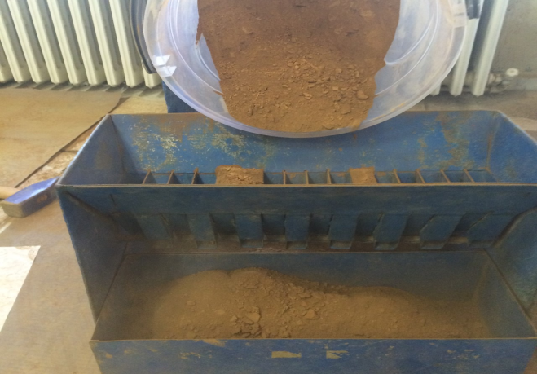
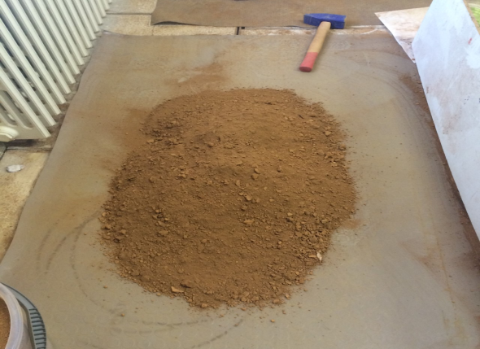
MATERIAL
The Pb-Zn oxide flotation plant tailing sample was provided from Yahyali-Kayseri, Turkey.
The supplied sample was dried and ground using a laboratory ball mill.
The particle size distribution of the ground sample was measured using Master Sizer 2000 (Malvern).
The mineralogical composition was determined by using X-ray diffraction (XRD) (Empyrean, PANalytical and Bruker Discovery-we are still studying on it).
The full elemental composition of the sample was performed by ALS Mineral Laboratory in Izmir, Turkey using inductively coupled plasma mass spectroscopy (ICP-MS).

Slide 4
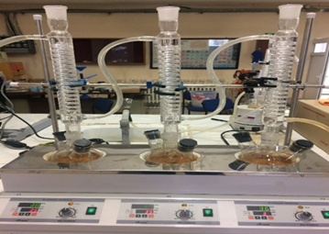
METHOD
The leaching tests were performed in a 500 mL rounded bottom glass reactor attached with glass condenser to prevent liquid evaporation. The glass reactor was placed in a heating mantle (Mtops) (Fig.1)
For each experiment, a required amount of organic acid at a pre-determined concentration was transferred into the reactor and then heated to the desired temperature before adding sample. At selected time intervals, 5 mL of slurry was withdrawn, and then the slurry was centrifuged at 5000 rpm. Supernatant liquor was analyzed by ICP-MS.
In the leaching tests, analytical grades of citric and oxalic were used. In all leaching tests, S/L ratio was maintained at 1/10. The percentage of metals dissolution was calculated based on the metal content in the leached solution.
Figure 1. Experimental set-up.

Slide 5
RESULTS AND DISCUSSION
Figure 2 shows the particle size distribution of the ground Pb-Zn oxide flotation tail sample. d₁₀ was around 1; d₅₀ 13; d₈₀ 57 and d₉₀ 100 µm. As can be seen from the graph, almost half of the sample is less than 10 µm in size.
Table 1. Chemical composition of the non-sulphide Pb-Zn flotation tailing by ICP-MS.
Element | wt %
Zn | 5.77
Pb | 7.50
Fe | 21.30
As | 4.2-5.60
Ca | 3.91
S | 1.85
Ag | 101 ppm
Figure 2. Particle sized distrubition of the ground sample.

Slide 6
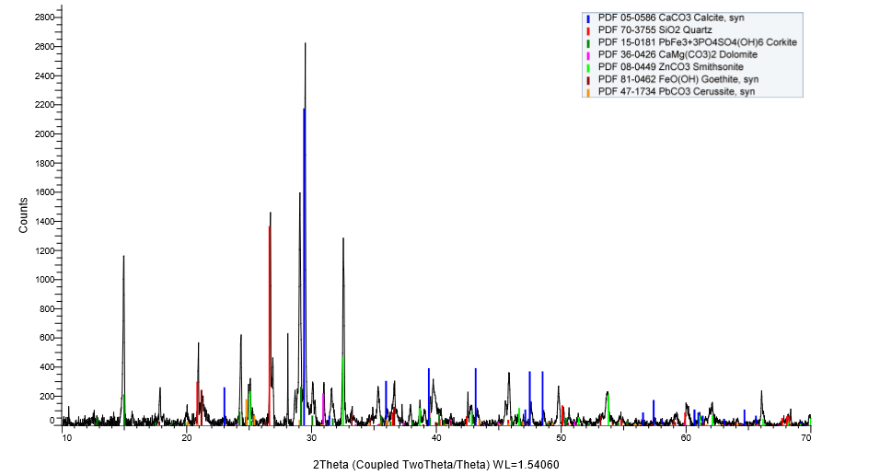
We are still working on the flotation tailing to determine mineral phases.
Table 2. Semi-quantitative mineral analysis of flotation tailing by XRD.
Minerals | % | Con. Level
Calcite | 47.7 | Major
Quartz | 20.5 | Major
Corcite | 11.6 | Major
Dolamite | 9.6 | Major
Simitsonite | 5.9 | Major
Goethite | 3.6 | Minor
Cerussite | 1.2 | Minor

Slide 7
EFFECT OF CITRIC AND OXALIC ACID ON DISSOLUTION
The reaction steps between zinc oxide and citric acid can (pH < 3) be written as follows (Demir et al., 2006 and Larba et al., 2013):
C₆H₈O_{7(s)} + H₂O_{(l)} ↔ H₃O_{+(aq)} + C₆H₇O₇⁻_{(aq)}
C₆H₇O₇⁻_{(aq)} + H₂O_{(l)} ↔ H₃O_{(aq)} + C₆H₆O₇²⁻ (aq)
C₆H₆O₇²⁻_{(aq)} + H₂O_{(l)} ↔ H₃O⁺(aq) + C₆H₅O₇³⁻(aq)
3ZnO(s) + 2C₆H₈O_{7(aq)} → 3Zn²⁺ + 2C₆H₅O₇³⁻_{(aq)} + 3H₂O_{(l)}
The dissolution of Fe complexes in oxalic acid can be express by (Lee et al, 2007; Weast, 1976 and Ferreira Jr et al, 2018):
H₂C₂O₄ → H⁺ + HC₂O₄⁻ → 2H⁺ + C₂O₄²⁻
Fe²⁺ + C₂O₄²⁻ + 2H₂O → FeC₂O₄∙2H₂O
Fe₂O₃ + 2HC₂O₄⁻ + 4H⁺ → 2Fe (C₂O₄)⁺ + 3H₂O

Slide 8
EFFECT OF CITRIC ACID ON DISSOLUTION
Figure 4 shows the effects of citric acid on dissolution of Zn, Pb, Fe and As from the flotation tailing at 60°C. Zn dissolution sharply increased with increasing leaching time within 30 min. and then gradually increased with increasing leaching time up to 120 min. Maximum 84.4% Zn was extracted into the leach solution from the flotation tailing by using 1.0 M citric acid within 120 min. leaching time at 60°C leaching temperature, while 14.7% As, 12.8% Fe and 10.9%Pb were co-dissolved. Metal extraction order changed as Zn>As>Fe>Pb under these conditions.
Figure 4. Effect of citric acid and leaching time on metal dissolutions (Conditions: citric acid concentration: 1 M, temperature: 60°C, S/L ratio:1/10).

Slide 9
EFFECT OF OXALIC ACID ON DISSOLUTION
In the case of 1.0 M oxalic acid concentration, Fe and As dissolution rates sharply increased again within 30 min. leaching time at 60°C leaching temperature and then slightly increased with increasing leaching time up to 180 min., whereas the Zn and Pb dissolution rates were remained relatively constant at 5% range (Fig. 5). Maximum 95.5% Fe and 68.8% As were taken into the leach solution along with less than 5% of Zn and Pb after 3h leaching time at 60°C.
Figure 5. Effect of oxalic acid and leaching time on metal dissolutions (Conditions: oxalic acid concentration: 1 M, temperature: 60°C, S/L ratio: 1/10).

Slide 10
EFFECT OF CITRIC AND OXALIC ACID ON DISSOLUTION
Therefore,
The tested results indicated that citric acid is the most appropriate lixiviant for the selective separation of Zn from the Pb, As and Fe containing flotation tailing samples.
It was also determined that there is no beneficial effect of oxalic acid on the Zn dissolution whereas oxalic acid has a crucial effect on the removal of Fe and As from the flotation tailing.
Hence, a citric acid leaching was decided to investigate for the separation of Zn, Pb and Fe from the flotation tailing.

Slide 11
EFFECT OF CITRIC ACID CONCENTRATION ON METAL DISSOLUTION
From Fig. 6, the maximum Zn dissolution was determined as 90.1% using 0.5 M citric acid at 80°C leaching temperature for 180 min. leaching time while the Fe, Pb and As dissolutions were between 7% and 17%.
Figure 6. Effect of citric acid and temperature on metal dissolutions (Conditions: citric acid concentration: 0.5 M, temperature: 80°C, S/L ratio: 1/10).

Slide 12
EFFECT OF CITRIC ACID CONCENTRATION ON METAL DISSOLUTION
Maximum 91% Zn was taken into the leach solution after 180 min. leaching time at 80°C leaching temperature while the Pb, Fe and As dissolutions were found to be between 10% and 20% (Figure 7). It was found that at 60ºC leaching temperature, metal dissolution order Zn>As>Fe>Pb and at 80ºC Zn>Fe>As>Pb.
Figure 7. Effect of citric acid and leaching time on metal dissolutions (Conditions: citric acid concentration: 1 M, temperature: 80°C, S/L ratio: 1/10).

Slide 13
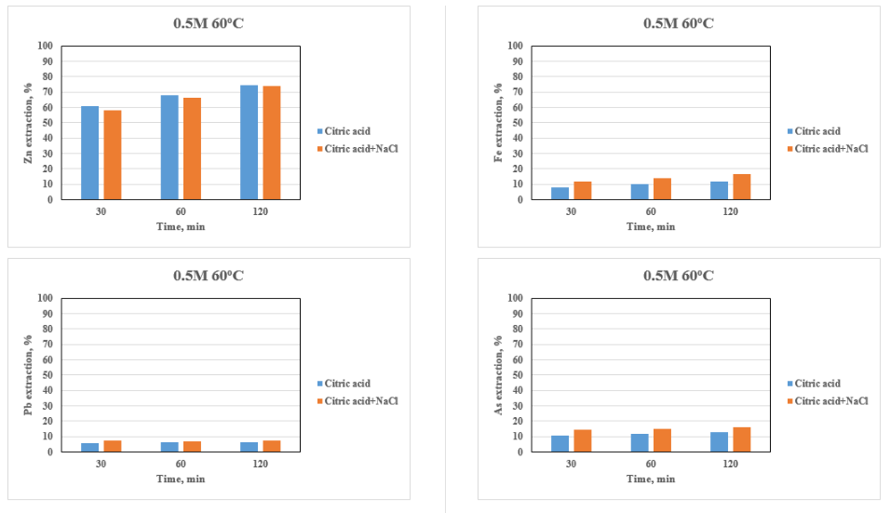
THE EFFECT OF CITRIC ACID IN THE PRESENCE OF NACl ADDITION
At 0.5 M citric acid and 0.05 M NaCl concentrations and 60ºC, Zn dissolution was 58.1% at 30 min and 74.0% at 120 min. Pb dissolution was 7.2% at 30 min. and 7.5% at 120 min. Fe dissolution was 11.9% at 30 min and 16.5% at 120 min. As dissolution was 14.5% at 30 min and 15.9% at 120 min. (Figure 8).
Metal extraction order changed as Zn>Fe>As>Pb under these conditions.
Presence of NaCl slightly decreased the Zn dissolution from 74.7% to 74% and increased As co-dissolution from 12.7% to 15.9%, Fe co-dissolution from 11.5% to 16.5% and Pb co-dissolution from 6.3% to 7.5%.
Presence of chloride anions along with H⁺ from citric acid catalyzed the dissolution of Zn and involve in the rate controlling step in the previous studies.
For our complex floatation tailing samples, addition of NaCl into citric acid, reduced the Zn dissolution and slightly increased impurity Fe and As dissolutions. Therefore, addition of NaCl to citric acid leaching for our samples is not desirable.
Figure 8. Comparison of the effect of citric acid and citric acid+NaCl on metal dissolutions.

Slide 14
CONCLUSIONS
The dissolution of Zn, Pb, Fe and As from the Pb-Zn non-sulphide flotation tailing by using citric and oxalic acid leaching was experimentally investigated.
Citric and oxalic acids were individually used to understand the effect of organic acids on Zn, Pb, Fe and As dissolutions.
The citric acid was determined as the most appropriate reagent for the selective dissolution of Zn. 90.1% Zn was leached using 0.5 M citric acid at 80°C for 180 min. while the Fe, Pb and As dissolutions were determined as less than 20%.
On the other hand, oxalic acid was removed the bulk of Fe and As impurities from the flotation tail. 95.5% Fe and 68.8% As were removed from the flotation tailing along with less than 5% of Zn and Pb using 1.0 M oxalic acid for 180 min. leaching time at 60°C.
Based on the experimental results obtained in the experimental campaign, a sequential citric + oxalic acid or oxalic + citric acid leaching method can be proposed for the selective leaching of Zn, Pb, Fe and As from the flotation tailing.
The main features of this proposal are that three separate streams can be developed by the sequential leaching method. The Zn can be separated by citric acid leaching from bulk of Fe and As and then Fe and As can be removed from the remained residue by oxalic acid, leaving lead in the final residue.

Slide 15
ORGANIC ACID LEACHING CONCEPT FOR FURTHER WORKS
INORGANIC + ORGANIC ACID LEACHING CONCEPT FOR FURTHER WORKS
Flotation tailing
Flotation tailing
Citric acid leaching
Zn in leach solution
Purification and separation of Zn
Sulphuric acid leaching
Zn in leach solution
Purification and separation of Zn
EW
EW
Oxalic acid leaching
Fe and As removal
Oxalic acid leaching
Fe and As removal
Pb reach in residue
Pb reach in residue

Slide 16
ACKNOWLEDGEMENTS
The authors thank to the ERA MIN 2 MINTECO Project and The Scientific and Technological Research Council of Turkey (TUBITAK) for financial support (Project No: 217M959).

